Slide 1
CS4102 Algorithms Spring 2021 – Floryan and Horton
Module 3, Day 6: Last DP Algorithms and
(1) Gerrymandering (not in the textbook)

Slide 2
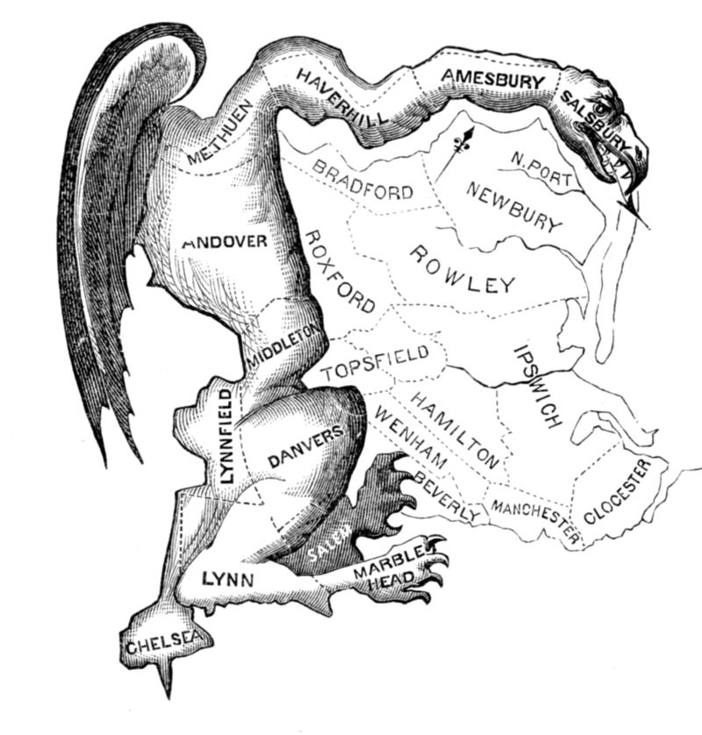
Gerrymandering
Manipulating electoral district boundaries to favor one political party over others
Coined in an 1812 Political cartoon
Governor Elbridge Gerry signed a bill that redistricted Massachusetts to benefit his Democratic-Republican Party
The Gerrymander

Slide 3
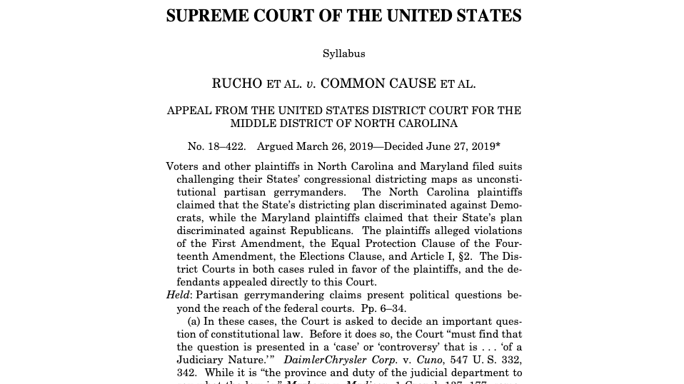
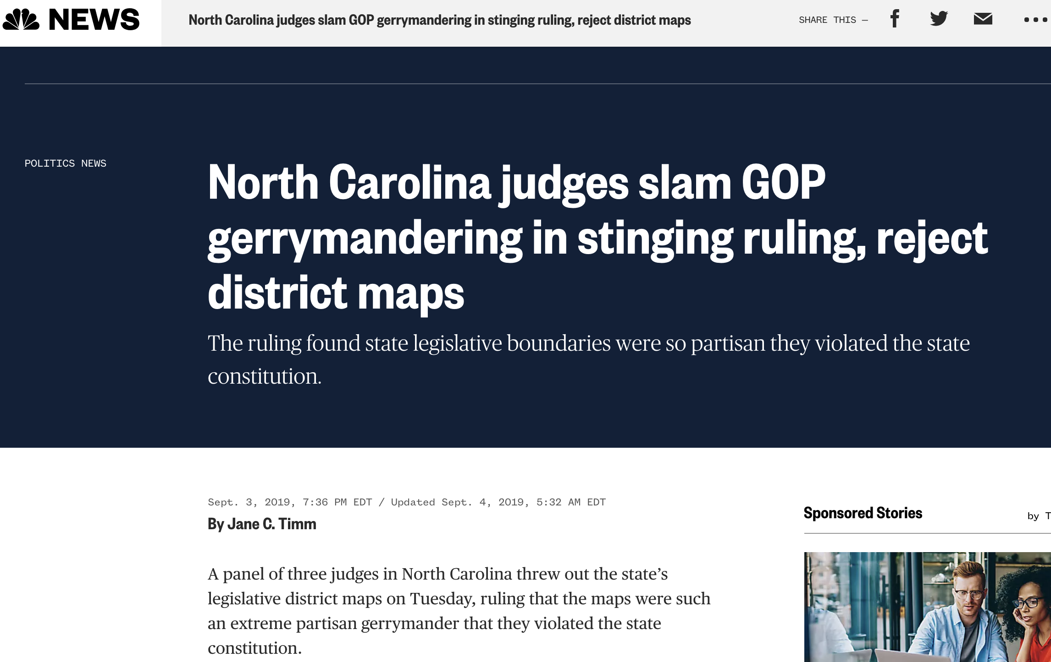
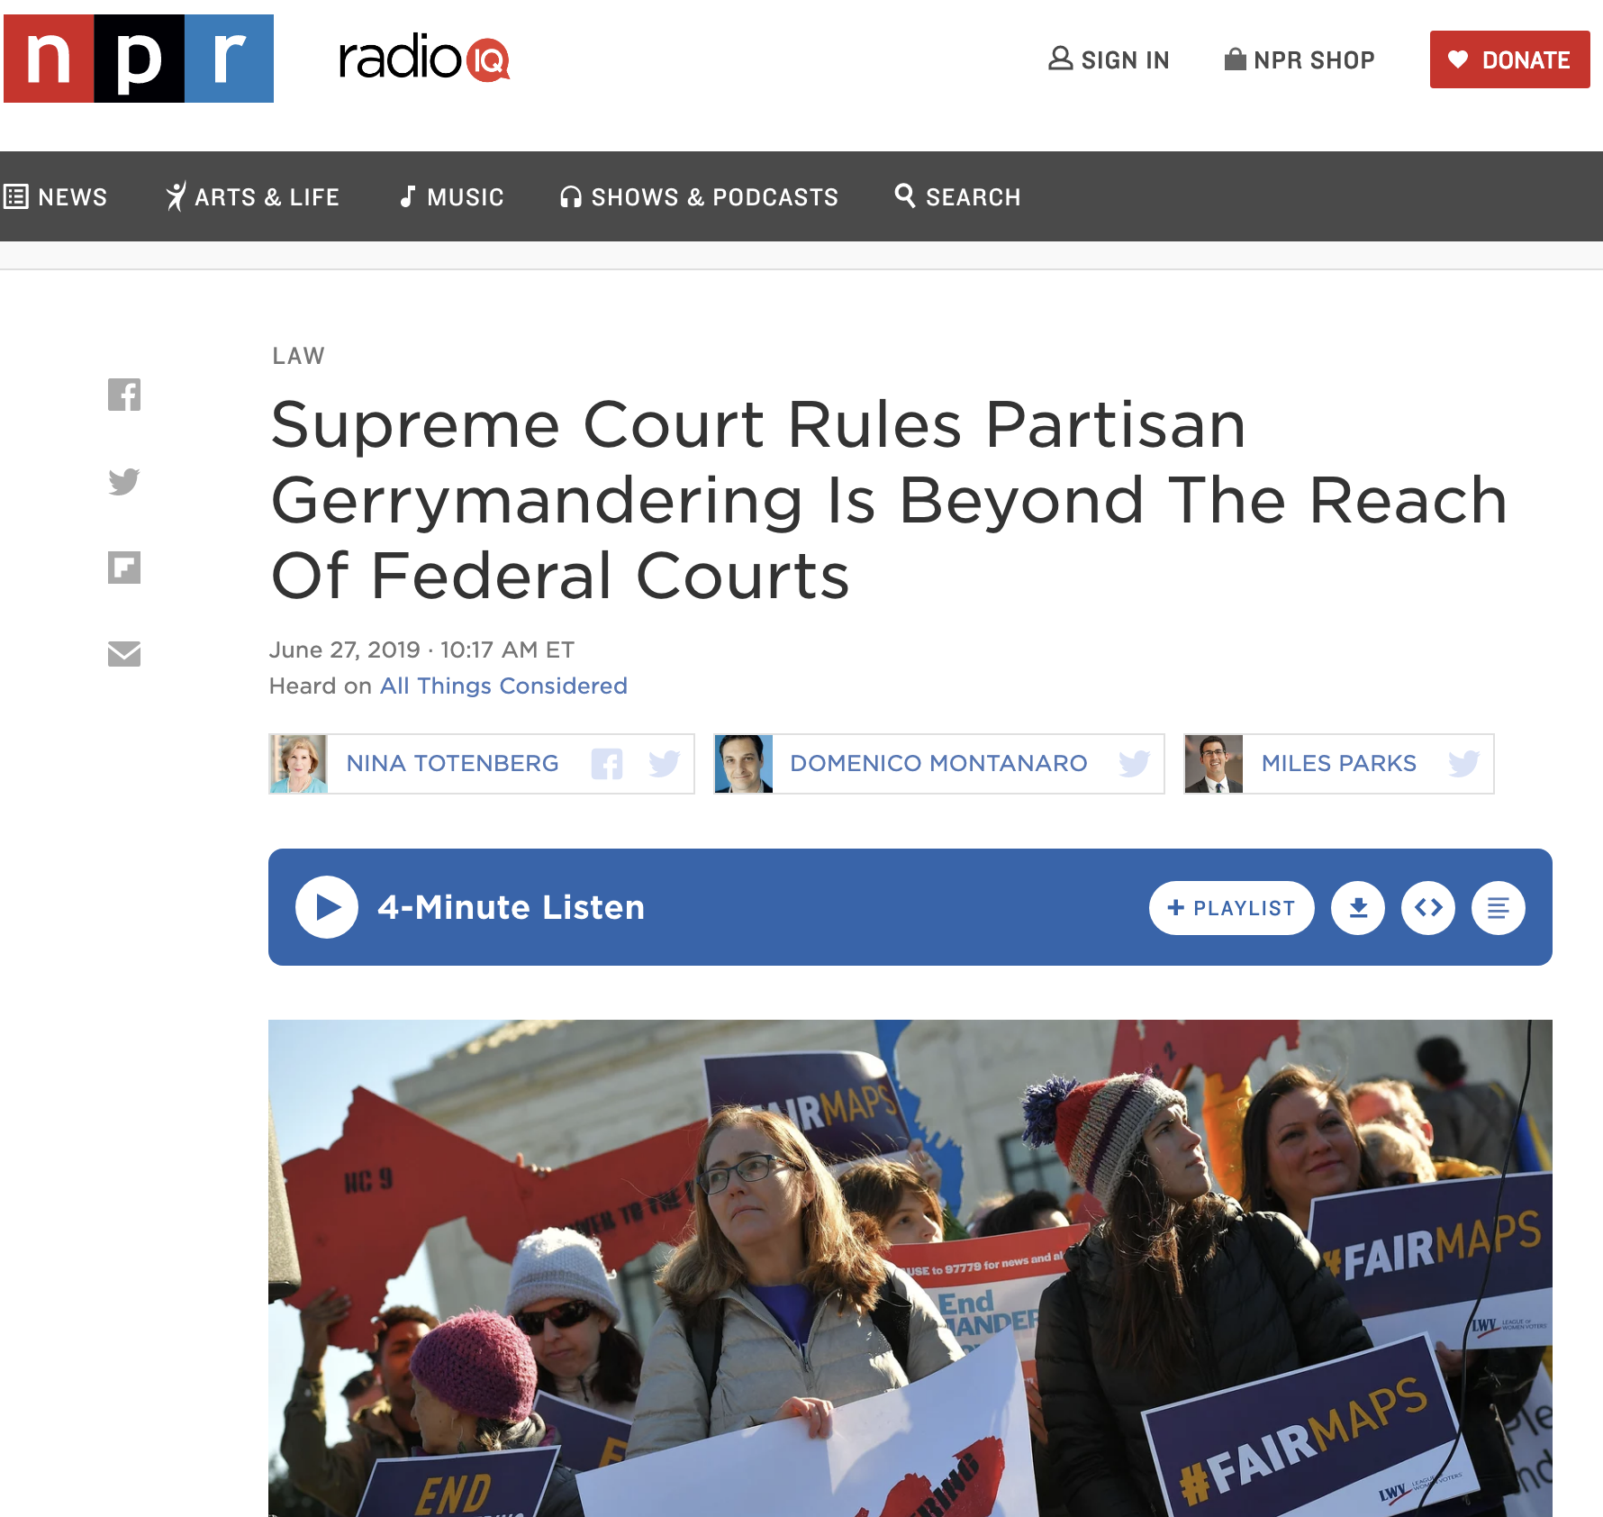

Slide 4
According to the Supreme Court
Gerrymandering cannot be used to:
Disadvantage racial/ethnic/religious groups
It can be used to:
Disadvantage political parties

Slide 5
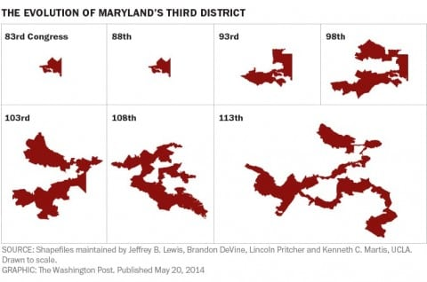
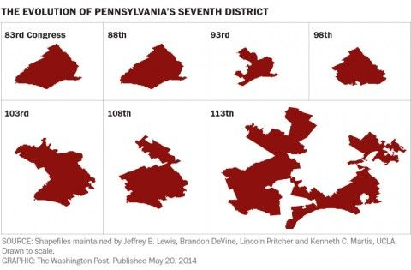
Gerrymandering Today

Slide 6
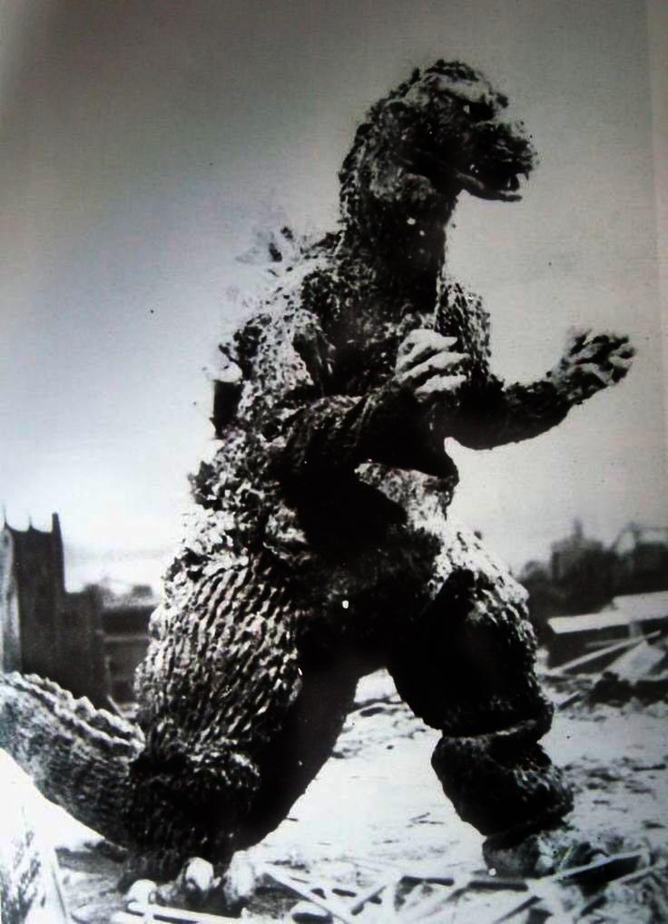
VA 5th Congressional District (2020)

Slide 7
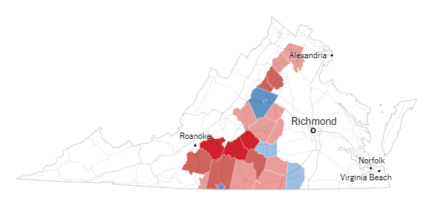
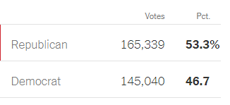
VA 5th District
2018 Election

Slide 8
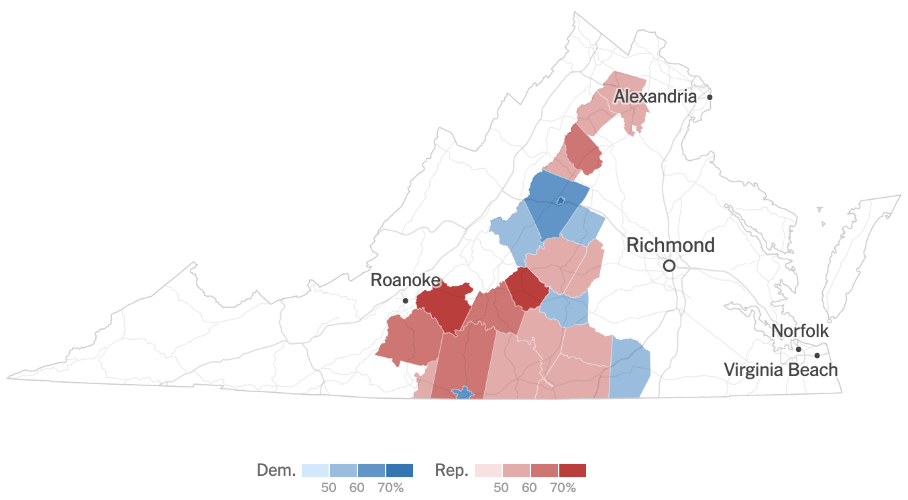
5th District 2020 HR Results

Slide 9
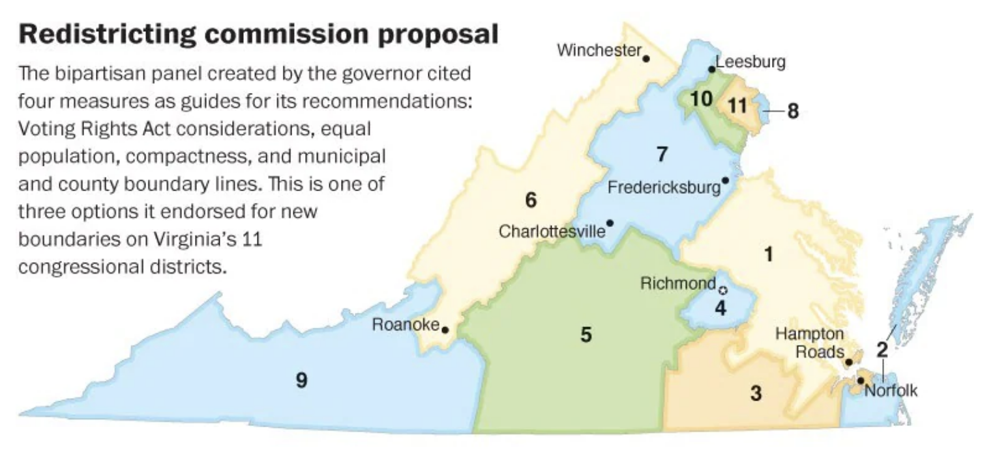
Some Thinking Before 2012 VA Congressional Redistricting
From: “Incumbents, not voters, shaping Virginia’s congressional districts.” Washington Post, 2011

Slide 10
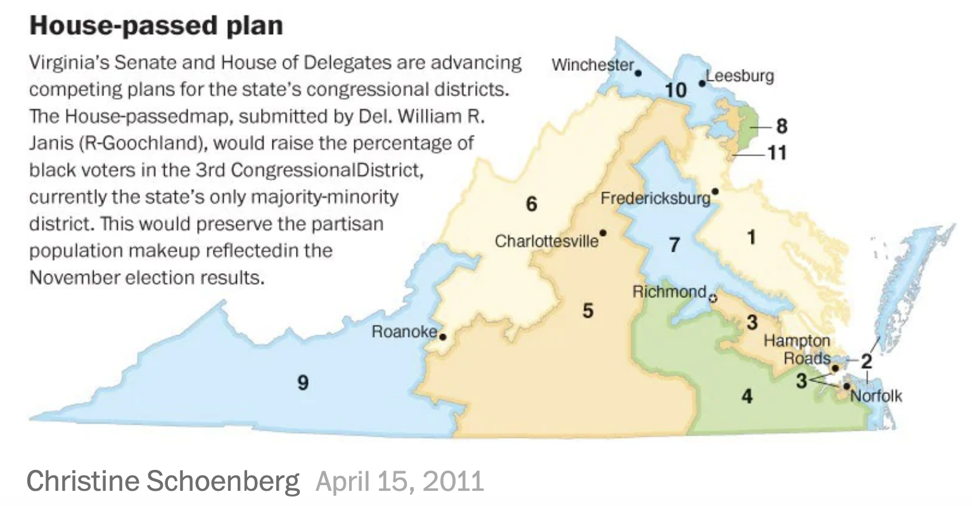
Political Reality and 2012 VA Congressional Redistricting

Slide 11
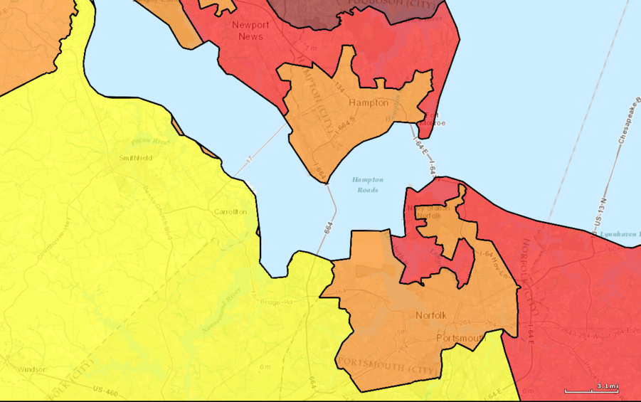
Seriously?
Computers make it really effective!
Close-up on part of 3rd District
This was 2013-2017; court ordered it changed
Virginia will do redistricting soon under a new system
Learn More about VA redistricting: https://www.vpap.org/redistricting/ https://redistricting.dls.virginia.gov/

Slide 12
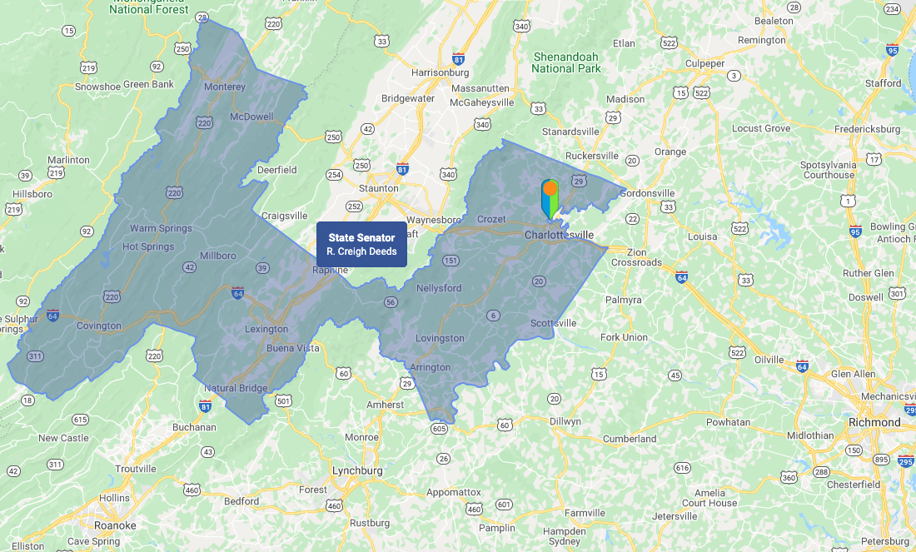
VA State Senate District 25 (2020)
My house marked!

Slide 13
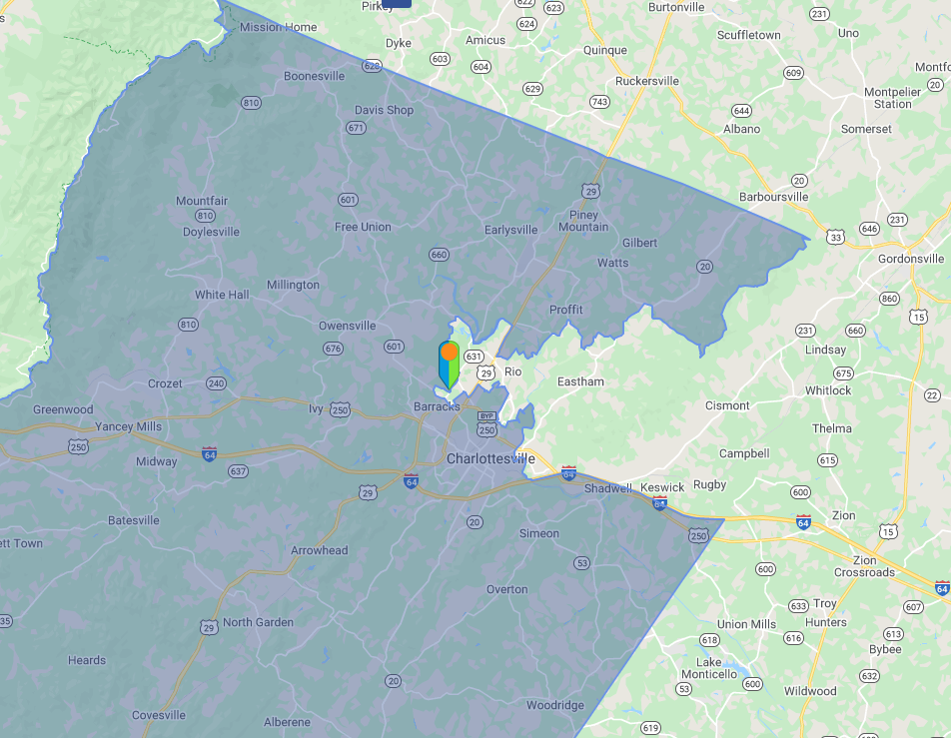
VA State Senate District 25 (2020)

Slide 14
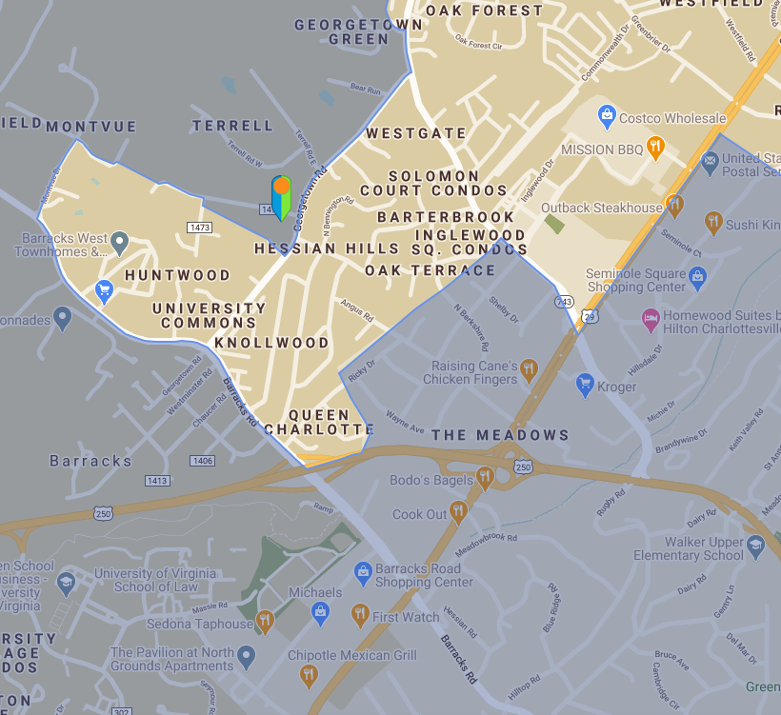
VA State Senate District 25 (2020)
Learn More about VA redistricting: https://www.vpap.org/redistricting/ https://redistricting.dls.virginia.gov/

Slide 16

An Algorithm to Gerrymander
It’s really a bit more complicated than this…
States are broken into precincts
All precincts have the same size
We know the votes for 2 parties in each precinct
Group precincts into districts to maximize the number of districts won by my party
The “Regular” Party
The “Diet” Party
Overall: R:217 D:183
Four precincts; 100 votes in each; Group into 2 districts
R:65
D:35
R:45
D:55
vs
R:60
D:40
R:47
D:53

Slide 17
How does it work?
States are broken into precincts
All precincts have the same size
We know the votes for 2 parties in each precinct
Group precincts into districts to maximize the number of districts won by my party
Each party gets one district
Regular Party gets both districts!
Overall: R:217 D:183
R:125 R:92
R:112 R:105
R:65
D:35
R:45
D:55
R:65
D:35
R:45
D:55
R:65
D:35
R:45
D:55
R:60
D:40
R:47
D:53
R:60
D:40
R:47
D:53
R:60
D:40
R:47
D:53

Slide 18
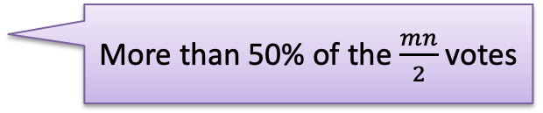
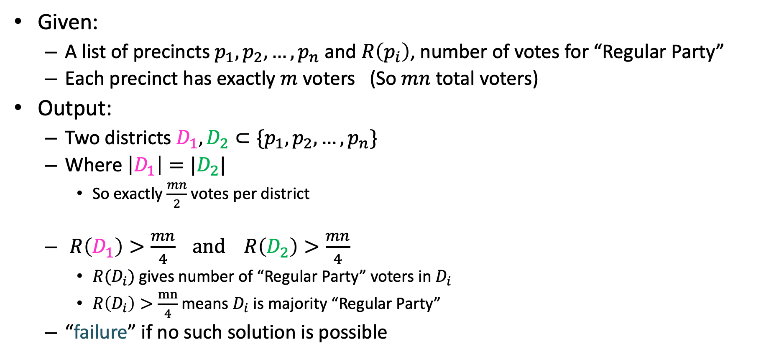
Gerrymandering Problem Statement
Given:
A list of precincts $p_{1},p_{2},…,p_{n}$ and $R\left(p_{i}\right)$, number of votes for “Regular Party”
Each precinct has exactly $m$ voters (So $mn$ total voters)
Output:
Two districts $D_{1},D_{2}⊂\{p_{1},p_{2},…,p_{n}\}$
Where $\left|D_{1}\right|=|D_{2}|$
So exactly $\frac{mn}{2}$ votes per district
$R\left(D_{1}\right)>\frac{mn}{4} and R\left(D_{2}\right)>\frac{mn}{4}$
$R(D_{i})$ gives number of “Regular Party” voters in $D_{i}$
$R\left(D_{i}\right)>\frac{mn}{4}$ means $D_{i}$ is majority “Regular Party”
“failure” if no such solution is possible
Valid Gerrymandering: Both districts go to Regular Party!
More than 50% of the $\frac{mn}{2}$ votes

Slide 19
Dynamic Programming
Requires Optimal Substructure
Solution to larger problem contains the solutions to smaller ones
Idea:
Identify the recursive structure of the problem
What is the “last thing” done?
Save the solution to each subproblem in memory
Select a good order for solving subproblems
“Top Down”: Solve each recursively
“Bottom Up”: Iteratively solve smallest to largest

Slide 20
Dynamic Programming
Requires Optimal Substructure
Solution to larger problem contains the solutions to smaller ones
Idea:
Identify the recursive structure of the problem
What is the “last thing” done?
Save the solution to each subproblem in memory
Select a good order for solving subproblems
“Top Down”: Solve each recursively
“Bottom Up”: Iteratively solve smallest to largest

Slide 21

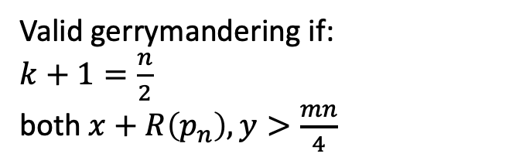
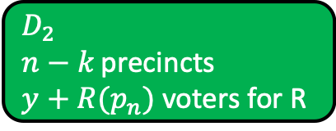


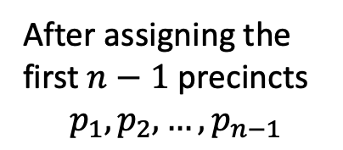
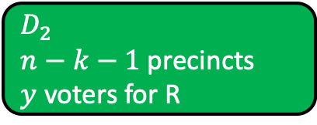

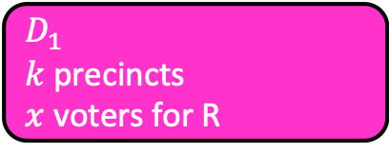

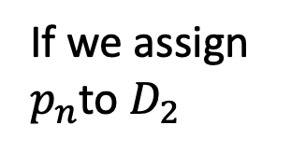

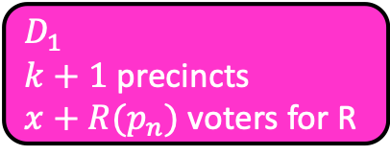
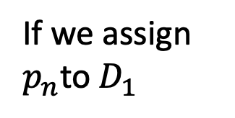


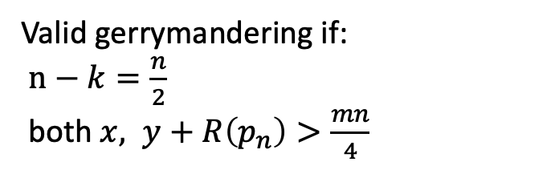
Consider the last precinct
World One
After assigning the first $n−1$ precincts $$p_{1},p_{2},…,p_{n−1}$$
$$D_{1} \\ k+1 \text{precincts}$$
$$x+R(p_{n}) \text{voters} \text{for} \text{R}$$
$$D_{1}$$
$k+1$ precincts
$x+R(p_{n})$ voters for R
If we assign $p_{n}$to $D_{1}$
$$D_{1}$$
$$D_{2} \\ n−k−1 \text{precincts}$$
$$y \text{voters} \text{for} \text{R}$$
$k$ precincts
$x$ voters for R
Valid gerrymandering if:
$k+1=\frac{n}{2}$
both $x+R\left(p_{n}\right), y>\frac{mn}{4}$
$$p_{n}$$
$$D_{2}$$
$n−k−1$ precincts
$y$ voters for R
World Two
$$D_{2}$$
$$D_{1} \\ k \text{precincts}$$
$$x \text{voters} \text{for} \text{R}$$
If we assign $p_{n}$to $D_{2}$
$n−k$ precincts
$y+R(p_{n})$ voters for R
$$D_{2} \\ n−k \text{precincts}$$
$$y+R(p_{n}) \text{voters} \text{for} \text{R}$$
Valid gerrymandering if:
$n−k=\frac{n}{2}$
both $x, y+R\left(p_{n}\right)>\frac{mn}{4}$

Slide 22
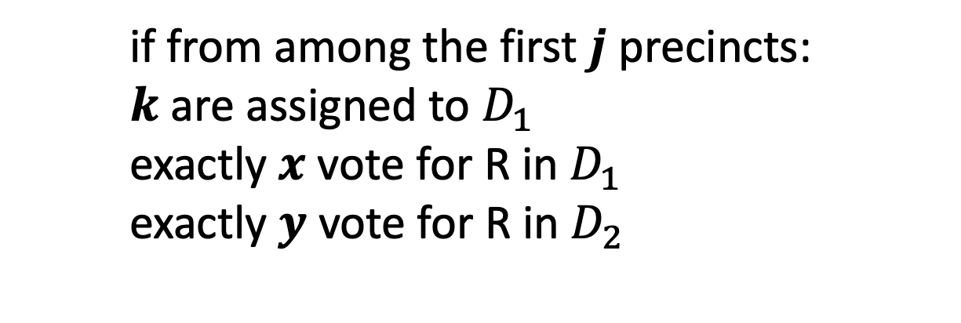
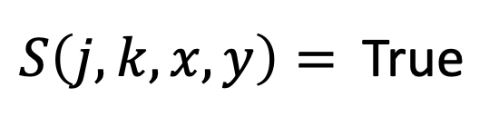
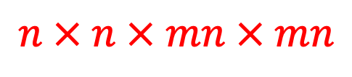
Define Recursive Structure
$S\left(j,k,x,y\right)=$ True
if from among the first $j$ precincts:
$k$ are assigned to $D_{1}$
exactly $x$ vote for R in $D_{1}$
exactly $y$ vote for R in $D_{2}$
$$n × n × mn × mn$$
4D Dynamic Programming!!!

Slide 23
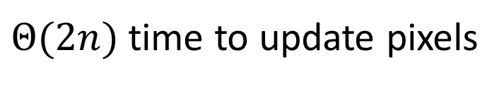
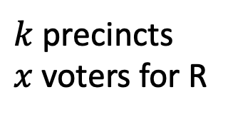
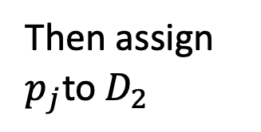
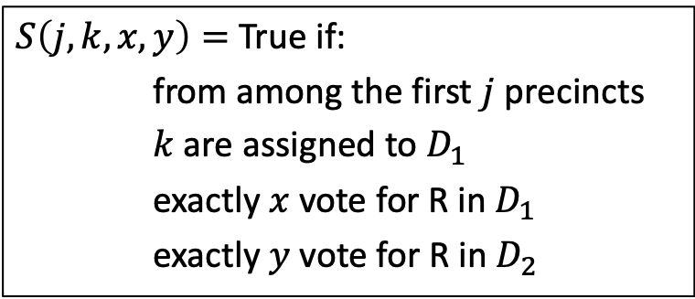

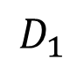
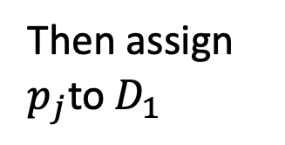
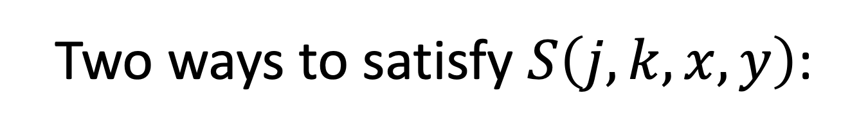

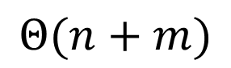
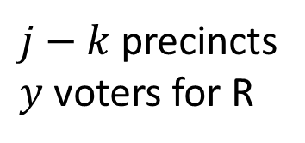
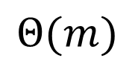
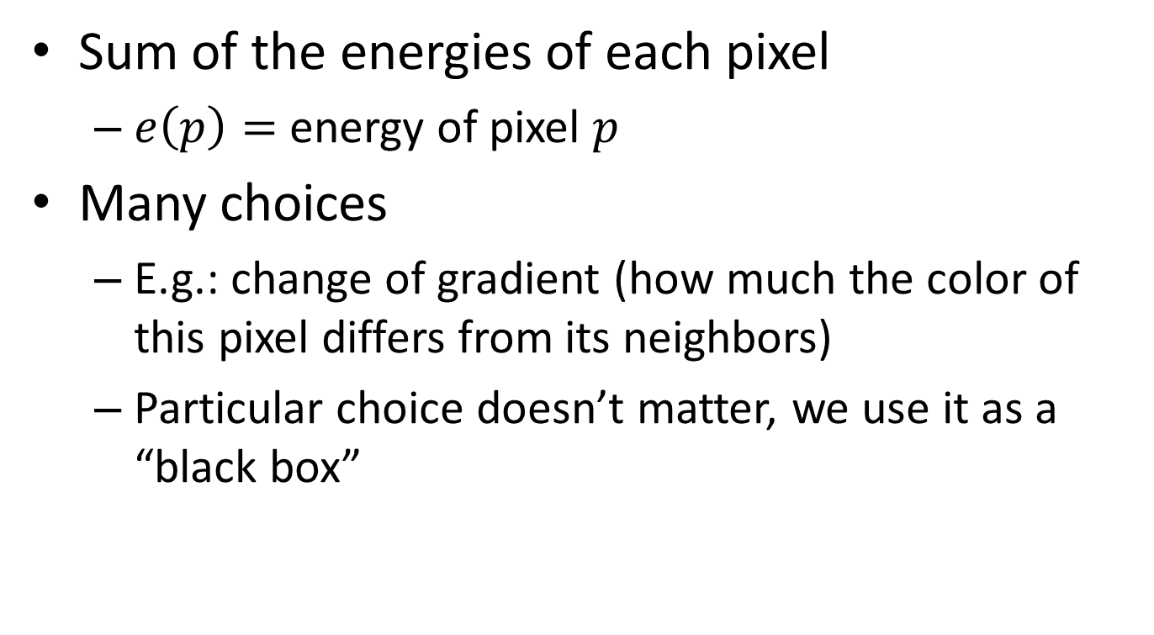
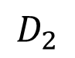

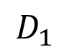
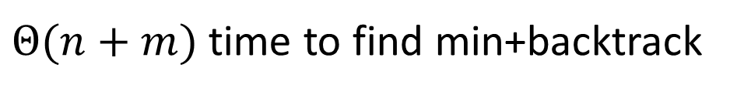
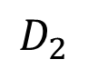
Two ways to satisfy $S\left(j,k,x,y\right)$:
$$D_{1}$$
$S\left(j,k,x,y\right)=$ True if:
from among the first $j$ precincts
$k$ are assigned to $D_{1}$
exactly $x$ vote for R in $D_{1}$
exactly $y$ vote for R in $D_{2}$
$k−1$ precincts
$x−R(p_{j})$ voters for R
$$p_{j}$$
$$D_{2}$$
Then assign $p_{j}$to $D_{1}$
$j−k$ precincts
$y$ voters for R
$$D_{1}$$
OR
$k$ precincts
$x$ voters for R
$$D_{1}$$
$k$ precincts
$x$ voters for R
$$D_{2}$$
$j−k$ precincts
$y$ voters for R
$$p_{j}$$
$$D_{2}$$
$j−1−k$ precincts
$y−R(p_{j})$ voters for R
Then assign $p_{j}$to $D_{2}$
$$S\left(j,k,x,y\right)=S\left(j−1,k−1,x−R\left(p_{j}\right), y\right)∨S\left(j−1,k,x,y−R\left(p_{j}\right)\right)$$

Slide 24
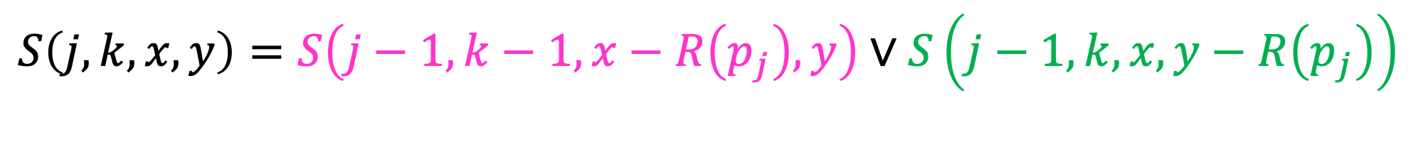
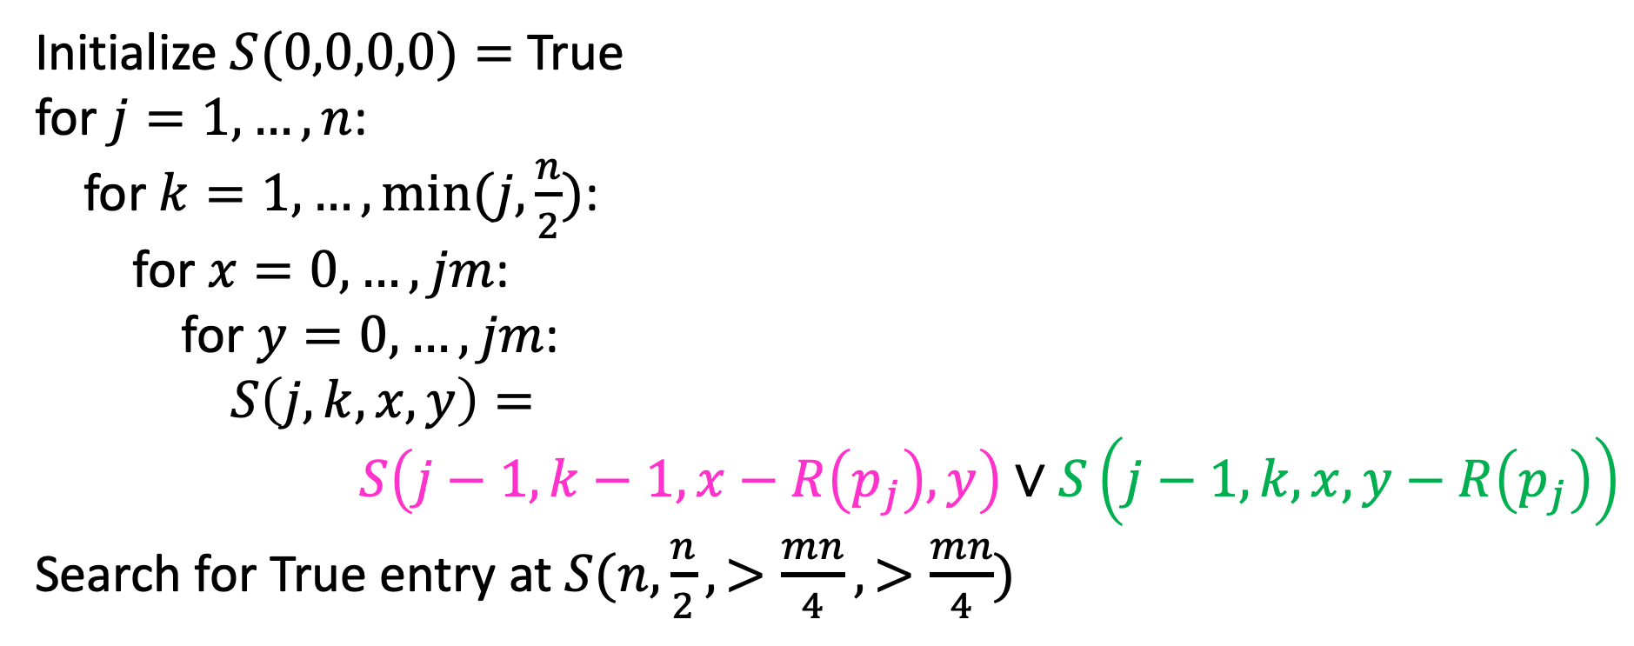
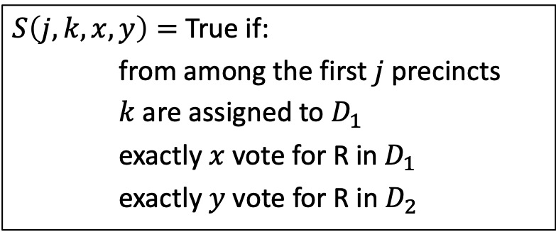
Final Algorithm
$$S\left(j,k,x,y\right)=S\left(j−1,k−1,x−R\left(p_{j}\right), y\right)∨S\left(j−1,k,x,y−R\left(p_{j}\right)\right)$$
Initialize $S(0,0,0,0)=$ True
for $j=1,…,n$:
for $k=1,…,min⁡(j,\frac{n}{2})$:
for $x=0,…,jm$:
for $y=0,…,jm$:
$S\left(j,k,x,y\right)=$
$$S\left(j−1,k−1,x−R\left(p_{j}\right), y\right)∨S\left(j−1,k,x,y−R\left(p_{j}\right)\right)$$
Search for True entry at $S(n,\frac{n}{2},>\frac{mn}{4},>\frac{mn}{4})$
$S\left(j,k,x,y\right)=$ True if:
from among the first $j$ precincts
$k$ are assigned to $D_{1}$
exactly $x$ vote for R in $D_{1}$
exactly $y$ vote for R in $D_{2}$

Slide 25
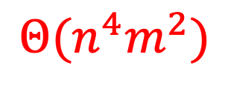


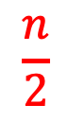

Run-Time
$$S\left(j,k,x,y\right)=S\left(j−1,k−1,x−R\left(p_{j}\right), y\right)∨S\left(j−1,k,x,y−R\left(p_{j}\right)\right)$$
Initialize $S(0,0,0,0)=$ True
for $j=1,…,n$:
for $k=1,…,min⁡(j,\frac{n}{2})$:
for $x=0,…,jm$:
for $y=0,…,jm$:
$S\left(j,k,x,y\right)=$
$$S\left(j−1,k−1,x−R\left(p_{j}\right), y\right)∨S\left(j−1,k,x,y−R\left(p_{j}\right)\right)$$
Search for True entry at $S(n,\frac{n}{2},>\frac{mn}{4},>\frac{mn}{4})$
$$n$$
$$\frac{n}{2}$$
$$Θ(n^{4}m^{2})$$
$$nm$$
$$nm$$

Slide 26





Can We Visualize this 4D “Table”?
$S\left(j,k,x,y\right)=$ True if:
from among the first $j$ precincts
$k$ are assigned to $D_{1}$
exactly $x$ vote for R in $D_{1}$
exactly $y$ vote for R in $D_{2}$
$$n$$
$$n/2$$
$$nm$$
$$nm$$
To get a solution: search for True entry at $S(n,\frac{n}{2},>\frac{mn}{4},>\frac{mn}{4})$

Slide 27

$$Θ(n^{4}m^{2})$$
This looks big! Yes, and it’s interesting too! ☺
Inputs:
List (size $n$) of precincts and counts of voters for Regular Party, $R\left(p_{i}\right)$
Number of voters (integer $m$)
$n$ is a size of one of the inputs
If $n$ doubles, twice as many items in the list that’s our input
But $m$is an input value (not a size)
If $m$ doubles, it’s still one integer, one input item
But the amount of work grows
The complexity depends on the size of this single integer

Slide 28

Size of a Numeric Input-Value
Question: How do we measure the size of an integer?
Answer: the number of bits to represent it.
Example: The value 4 (decimal) in binary is 100, so the size of “value 4” is 3.
If the size grows by 1, that’s 4 bits. With 4 bits, the value could be 1000 or 8 decimal.
Wait, what? Size of input grows by 1, and the value doubles (4 to 8). That sounds like exponential! $2^{n}$vs. $2^{n+1}$

Slide 29

Pseudo-Polynomial Time
Yes, the inputSize (in bits) of value $m$ is $\log_{2}{m}$ $inputSize{=log}_{2}{m}$
$m=2^{inputSize}$
So $m^{2}={{(2}^{inputSize})}^{2}$= $2^{2∙inputSize}$
Gerrymandering’s run-time is exponential because of size of input $m$
Because run-time $Θ\left(n^{4}m^{2}\right)$ written in terms of the value of $m$, not the size of $m$
Input size is really $n+\left|m\right|=n+\log{m}$
This is called pseudo-polynomial time (https://en.wikipedia.org/wiki/Pseudo-polynomial_time)
We’ve seen others like this! Knapsack DP $Θ(n∙C)$ and Coin-changing DP $Θ(n∙A)$

